Slide 1
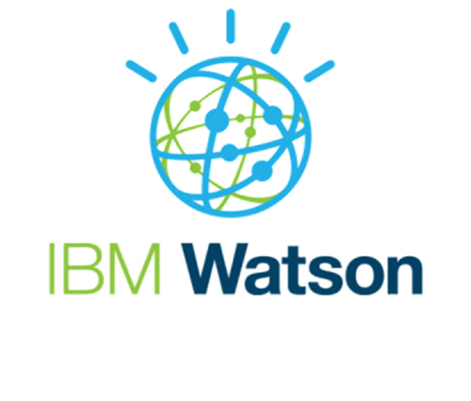
BUILD-YOUR-OWN
CHATBOT
Watson Assistant 101
Labs Gary Wilson CTO & Technical Leader, UKI Commercial Business

Slide 2

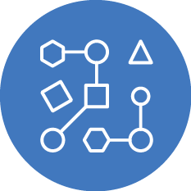
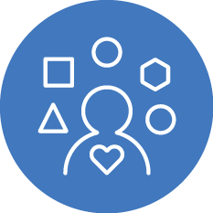



IBM Watson Assistant
Create natural language interactions to better serve your end-users
Leverage machine learning approaches to improve the conversational model
Create an omni-channel experience for better user engagement
Get started quickly with pre-built content
Walk users through business processes like application forms or resetting a password
Scale from a simple chatbot to supporting millions of conversations in one solution

Slide 3
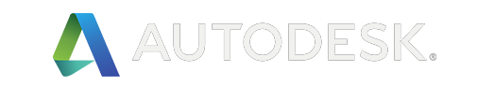
99%
improvement in customer response times for Autodesk by implementing Watson
5-10 min
to resolve cases as opposed to a day and a half. And the only reason it takes five to 10 is because that’s how long a customer needs to type in or find a specific information, such as matching a serial number to an entitlement or contract
For more than 34 years, software giant Autodesk sold its popular 3D design, engineering and entertainment software under perpetual desktop licensing agreements. However, the way customers wanted to buy and access products changed.
Recognizing that shifting to a subscription business model requires real-time customer service and support. Autodesk developed a virtual agent interact with customers and improve their experiences
100,000
supported per month, easing the burden on call center staff
conversations
14 M
total sentences analyzed for keywords, entities, phrases, clusters, and other speech and language patterns
60 cases
recognized distinct use cases to quickly resolve easy requests so that agents can focus on helping customers with complex issues
5.4 mins
of resolution time for most inquiries, drastically down from 1.5 days
+10 pt
increase in customer satisfaction levels because customers don’t have to wait as long to have their questions answered
Notes:
Some of these customer experience improvements are pretty staggering
Resolution time DOWN from 1.5 days to 5 minutes
100k CONVERSATIONS managed per month – that Autodesk staff now don’t have to deal with
Whilst INCREASING customer satisfaction by 10 points
IMPORTANT: it doesn't matter the SIZE of your organisation, the CAPABILITIES Watson Assistant provides are the same

Slide 4
Why IBM Watson Assistant?
Scalable solution
An enterprise can go from a single user to supporting millions of conversations across its organisation with a single solution.
Simplified tooling
Allows collaboration between business users and developers to build out conversational solutions and advanced dialog flows, without needing to be an expert in Machine Learning.
Security
Provide enterprise-grade security and support, such as data isolation, end to end encryption, and support for non-regulated PII data.
Deep industry expertise and partnerships
e.g., health, banking, automotive, retail
Data Control
Clients maintain control and ownership of their data. IBM will not share unique insights derived from clients data without client’s agreement.
IBM Cloud Private: On-premises plan
One of the only vendors in the market that allows you to deploy and run a virtual assistant on your own infrastructure, behind your firewall.
Notes:
- Platform is SCALABLE, SECURE and provides a really simple way to build your VA
- One thing I would draw your attention to is DATA CONTROL
- When you use IBM Watson, Cloud & Analytics....
- WE DO NOT share any of your DATA or INSIGHTS with others - this means the only people who benefit from your AI implementation is you and your partners

Slide 5
Workshop Objective
Create a basic chatbot to help guide you when buying a new mobile phone / contract
IBM Cloud
Watson Assistant

Slide 6
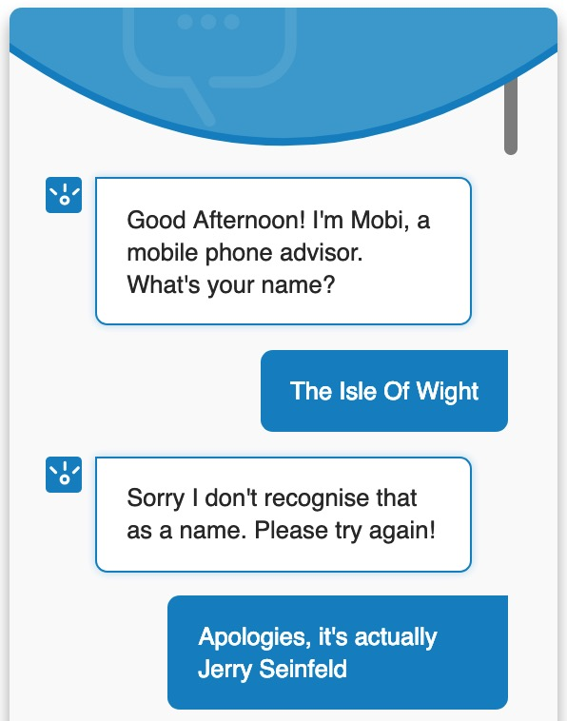
Your Chatbot!
1 – greet user
2 – check for valid name

Slide 7
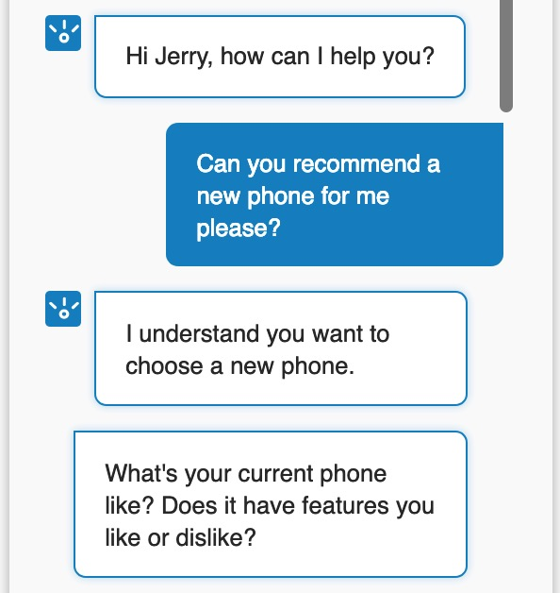
Your Chatbot!
3 – personalise / shorten name
4 – understand user intent
(phone recommendation)
5 – ask qualifying question

Slide 8
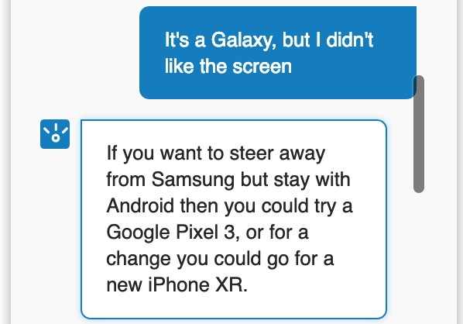
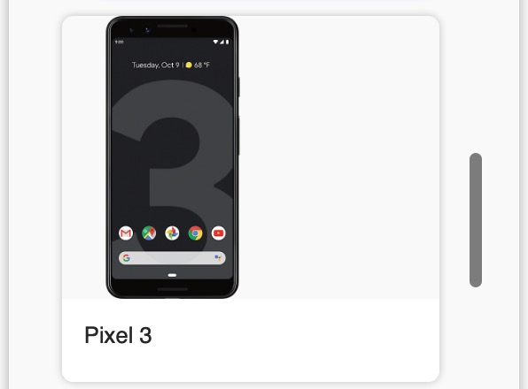
Your Chatbot!
6 – understand user sentiment
and recommend alternative
7 – enhance user experience
using images

Slide 9
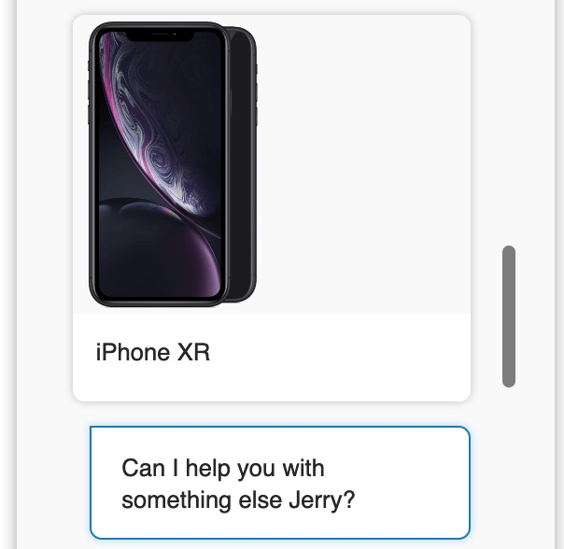
Your Chatbot!
8 – reuse name

Slide 10
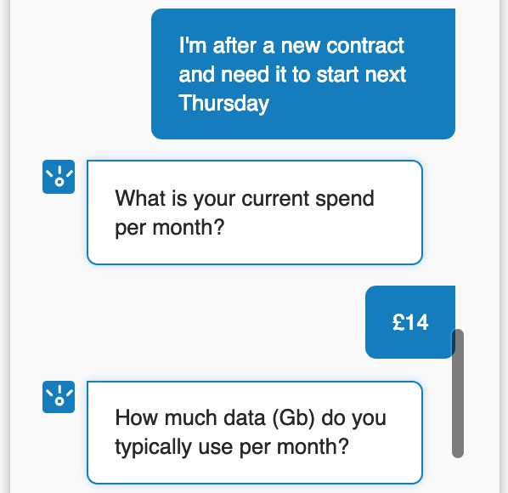
Your Chatbot!
9 – understand user intent
(contract recommendation)
10 – gather multiple pieces of
data to customise response

Slide 11
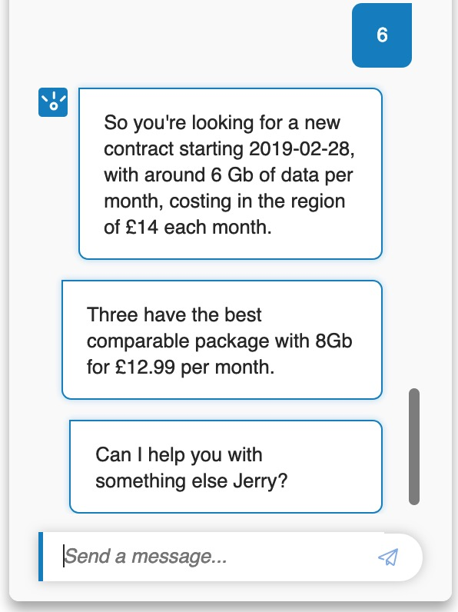
Your Chatbot!
11 – confirm user data
12 – provide contract
recommendation

Slide 12
How Does Watson Assistant Work?
Combines:
machine learning
natural language understanding
graphical dialog tools
… to create conversation flows between you and your users
Basic terms
Skill
a container for all of the artefacts that define a conversation flow
Intent
Entity
Dialog

Slide 13
Intents and Entities
Intents are a purpose or goal expressed by a user’s input
recognise user’s intent => choose the correct response
train Watson Assistant with multiple examples
Entities represent a class of object
can be used to trigger different responses, even for same intent
In our labs:
intents
newphone (‘I want to get a new phone’, ‘I’d like advice on a new mobile’,…)
positive (‘I like my Galaxy’, ‘I love my Google phone’, …)
negative (‘I don’t like my iPhone’, ‘I hate my Pixel 2’, …)
entities
brand (Apple, Samsung, Google, …)
attribute (style, battery, …)

Slide 14
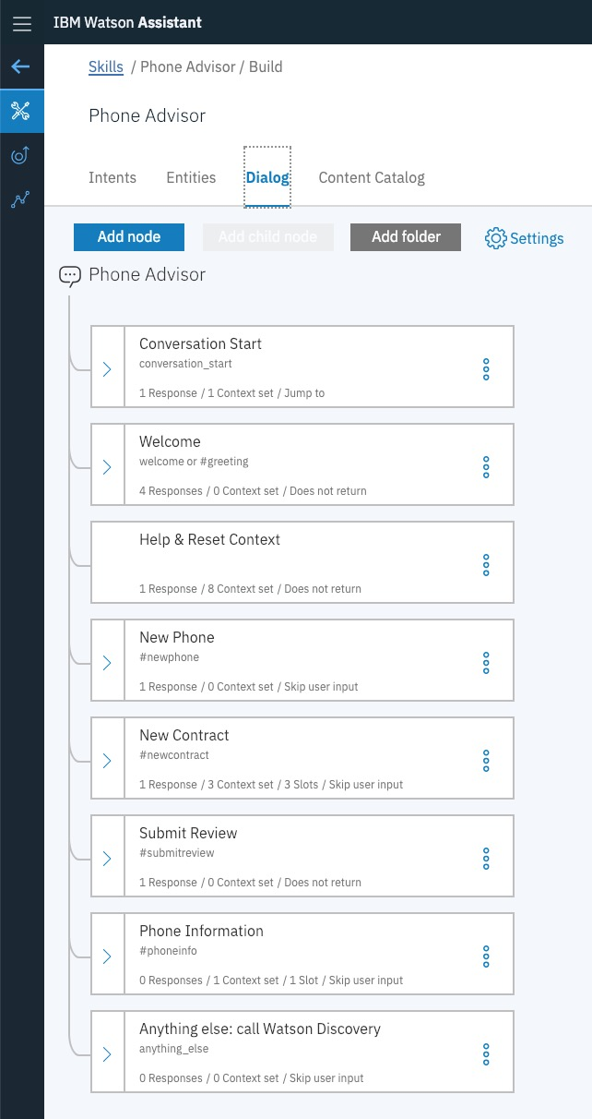
Dialog
Defines the flow of your conversation in the form of a logic tree
Each node of the tree has a condition that triggers it, based on user input
Uses intents and entities
Interacts with the user and provides a response
text, images, options

Slide 15

Workshop Agenda
Setup Watson Assistant
Create a skill
Create intents, entities
Create a dialog tree utilising both intents and entities
Test your chatbot
Create a live, web-hosted version of your chatbot

Slide 16
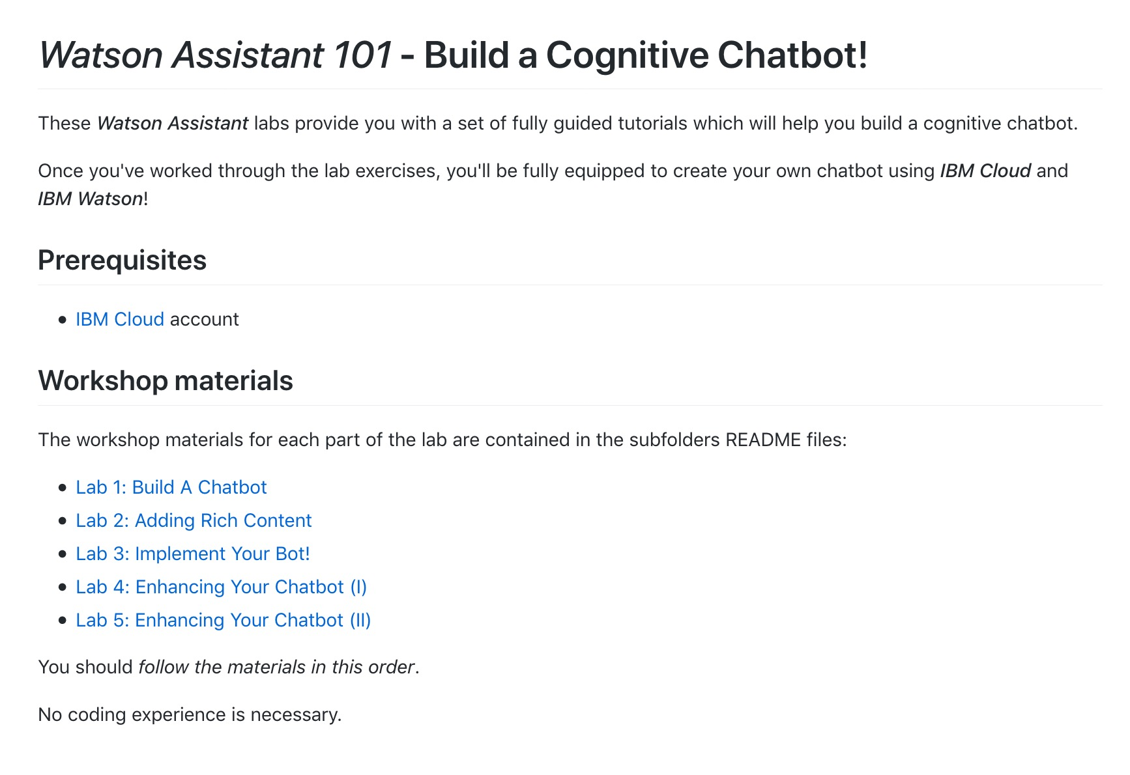
Lab Format
Step-by-step instructions
GitHub README.md for each lab
Work at your own pace
https://github.com/garyrwilson/Watson-Assistant-101

Slide 17

BUILD-YOUR-OWN
CHATBOT
Watson Assistant 101
Labs Gary Wilson CTO & Technical Leader, UKI Commercial Business

